Slide 1


அரசினர் பொறியியல் கல்லூரி - போடிநாயக்கனூர்
GOVERNMENT COLLEGE OF ENGINEERING, BODINAYAKKANUR – 625582
A Tamilnadu Government Education Institution
Affiliated to Anna University, Chennai
Department of Electronics and Communication Engineering
Presentation Meeting for EC8811-Project Work
Date: 13 MAY 2024
ADVANCED EMERGENCY VEHICLE ALERT SYSTEM IN URBAN ENVIRONMENT USING LORA SHIELD
Presented by,
T.Ashok-923320106004
S.V.Rexshen-923320106037
A.Sanjay-923320106038
M.Sanjay Kumar-923320106039
Under The Guidance of,
Mr.M.Rajamadasamy,
M.Tech.,

Slide 2
OVERVIEW
Traffic congestion has become a significant issue in cities due to the rise in vehicle population.
Poor traffic management contributes to a rise in fatalities and accidents.
An emergency vehicle alert system, often known as EVAS, is suggested as a solution to this issue.
Both life and property are saved by this technique.

Slide 3
OBJECTIVE
• By using the emergency vehicle to broadcast a signal that will be picked up by automobiles in front, alerting drivers.
• To inform nearby motorists of the emergency vehicle, and to create the system with the appropriate inputs.
• To combine the required software with the requisite physical components.
• To create a user-friendly, readily accessible system.

Slide 4
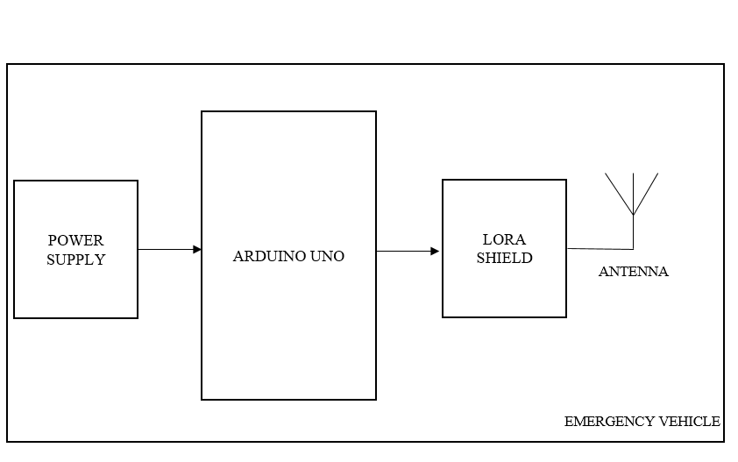
BLOCK DIAGRAM
TRANSMITTER

Slide 5
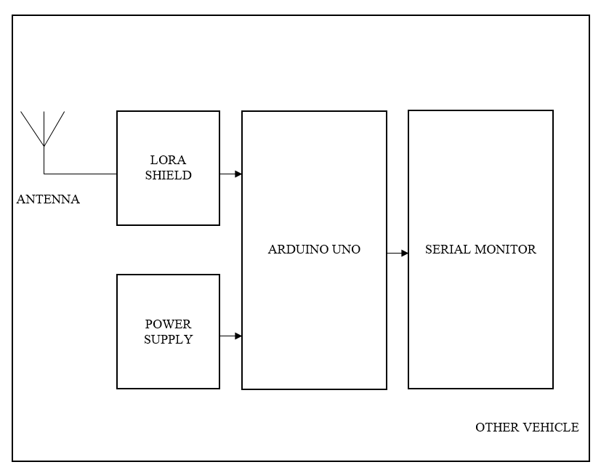
RECEIVER

Slide 6
DESCRIPTION OF BLOCK DIAGRAM
There are a transmitter unit and a receiver unit in this system.
Both units include an Arduino UNO serving as a processing unit and a Long Range (LoRa) Shield for communication.
The receiver device is targeted by the LoRa Module's emission of specific frequency waves.
Reception unit detects the frequency that the transmitter unit emits.
It uses that information to activate serial monitor.

Slide 7
DESCRIPTION OF BLOCK DIAGRAM
An Arduino board is interfaced with a LoRa Shield to create the Advanced Emergency Vehicle Alert System (AEVAS), which is installed on emergency vehicles.
A LoRa Shield, serial monitor, and Arduino board were used in receiver side, which is installed on commuter cars.
If there are any cars with LoRa receivers nearby, they will pick up the signal and show the message on serial monitor.
Serial monitor won't show any messages if the signal is not received.

Slide 8
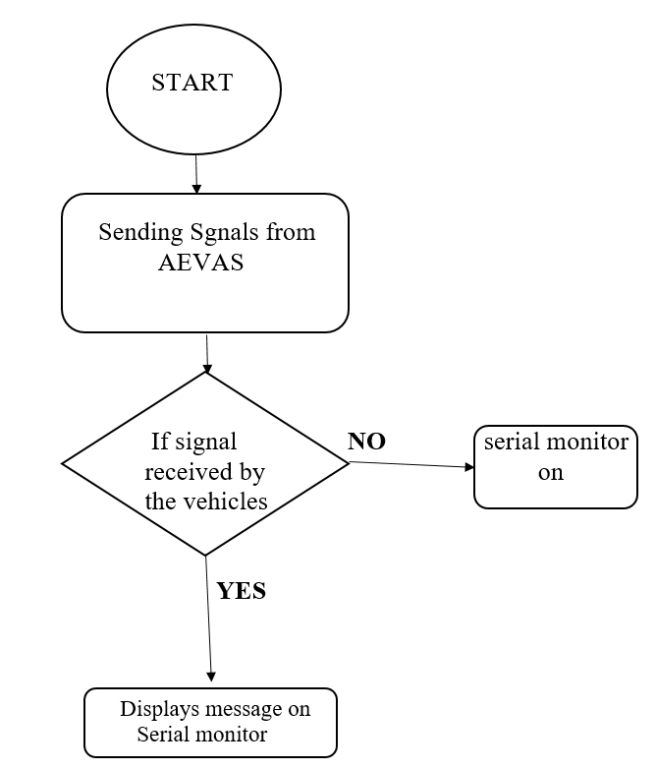
FLOWCHART

Slide 9
LITERATURE SURVEY
TITLE OF THE PAPER | AUTHORS | YEAR OF PUBLICATION | DESCRIPTION | DRAWBACK
Alert System for Emergency Vehicles Using Software-Defined Radio | Carlos Bosquez, Ronald Moreira, Alexis De La Cruz | 2017 | SDR transmits radio signal from 88 MHz to 108 MHz using free software (such as GNU Radio and Python) with the help of USRP desired radio signal is generated and transmitted using yagi antenna. | Carlos Bosquez stated that the overlapping of frequency,poor transmission range and the Power consumption is high
Evaluation of Low-Power Long Distance Radio Communication in Urban Areas: LoRa and Impact of Spreading Factor | Selim Sagar, Ismail Kaya, Cem Sisman. | 2019 | LoRa is a wireless communication technology for Long-range transmission. Data is transmitted in the form of packets Better data rate is achieved by reducing spreading factor. | In densely populated area there is poor line of connection between transmitter and receiver.

Slide 10
LITERATURE SURVEY
Smart Ambulance Approach Alarm System Using Smartphone | Toru Kobyashi, Fukuyoshi Kimura, Kenichi Arai | 2019 | The position of emergency vehicle is shared with other vehicles within the range of 500m, using the live data in the cloud server | Software glitch, Poor network Connectivity affects the timely response of the system.
EVAS – Emergency Vehicle Alert System using LoRa for automobiles | Sanjay S Tippannavar, Puneeth K M, Yaswanth S, Madhu Sudan M P | 2023 | The lora based transceiver is fixed in cars and emergency vehicle it is processed using the arduino and the alert message is displayed to the nearer vehicles. | Arduino posses limited processing power ,range of transmission is not mentioned.

Slide 11
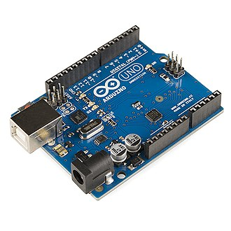
ARDUINO
The Arduino UNO board is equipped with sets of digital and analog input/output (I/O) pins that may be interfaced to various expansion boards (shields).
The board has 14 digital I/O pins and 6 analog I/O pins.
Also it is programmable with the Arduino IDE via type B USB cable.

Slide 12
PINOUT CONFIGURATION
Reset | Reset | Resets the microcontroller.
Analog Pins | A0 – A5 | Used to provide analog input in the range of 0-5V
Input/Output Pins | Digital Pins 0 - 13 | Can be used as input or output pins.
Serial | 0(Rx), 1(Tx) | Used to receive and transmit TTL serial data.
External Interrupts | 2, 3 | To trigger an interrupt.
PWM | 3, 5, 6, 9, 11 | Provides 8-bit PWM output.

Slide 13
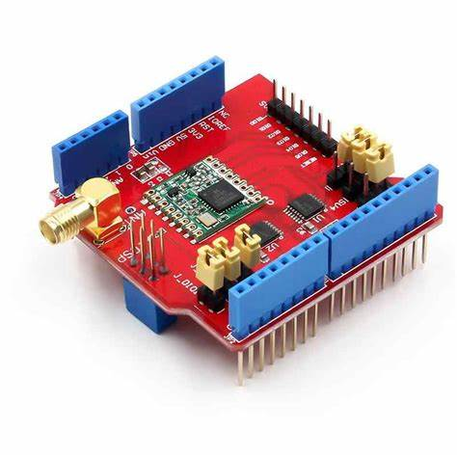
LORA SHIELD
The Dragino Lora Shield is a long range transceiver on a Arduino shield form factor and based on Open source library.
The Lora Shield allows the user to send data and reach extremely long ranges at low data-rates.

Slide 14
LORA SHIELD
The Lora Shield based on SX1276/SX1278 targets professional wireless sensor network applications.
Eg. irrigation systems, smart metering, smart cities, smartphone detection, building automation, and so on.

Slide 15
FEATURES
Compatible with 3.3v or 5v I/O Arduino Board.
Frequency Band: 915MHz/868 MHZ/433 MHZ (Pre-configure in a factory)
Low power consumption
Compatible with Arduino Leonardo, Uno, Mega, DUE
External Antenna via I-Pex connector

Slide 16
USAGE NOTICE
BETTER PERFORMANCE IN,
Outdoor environment.
﻿No obstacles.
﻿No high level radio interferer in the ISM 868MHz band.
﻿At least 1 meter above the ground.

Slide 17
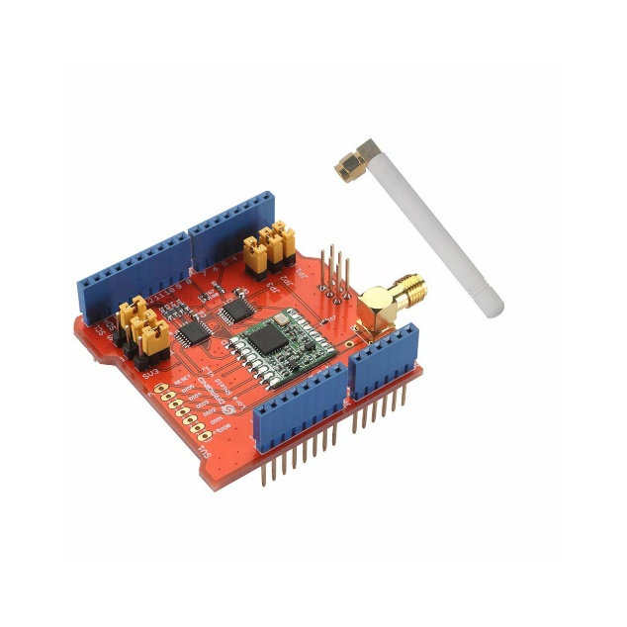
LORA ANTENNA
A LoRa antenna is a device that extends the range of low-power wide-area networks.
It facilitates communications with minimal power consumption.
The primary application of the antenna is in low-power wireless devices.
These devices are useful in the IoT and Machine to Machine (M2M) communications.

Slide 18
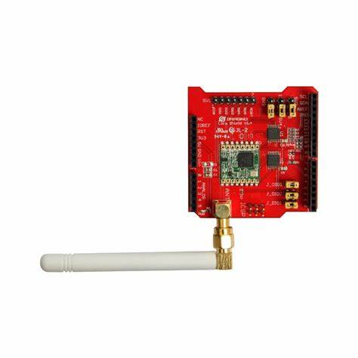
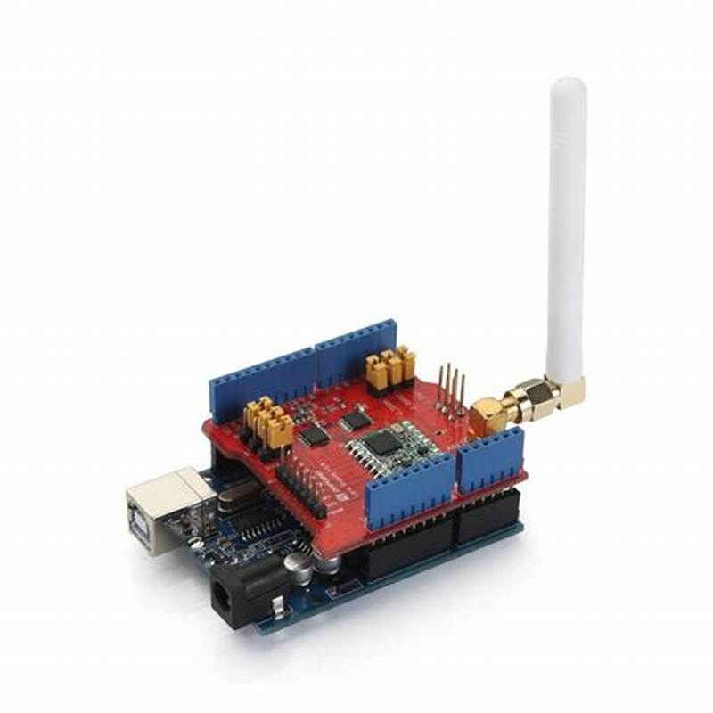
MOUNT AND INSTALLATION
They can be mounted horizontally or vertically, depending on your application needs.
Installing a LoRa antenna is not difficult.
Before installation, it’s important to check the antenna for tight connections.
Also, ensure the mounting structure is secure.
After installation, you should check the antenna’s orientation and adjust it to ensure optimal performance.

Slide 19
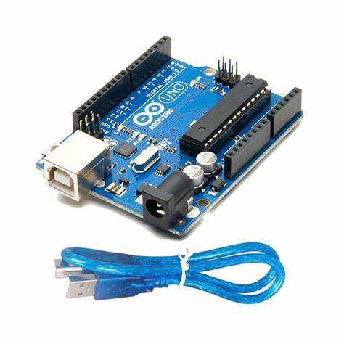
USB CABLE
This is a standard-issue USB 2.0 cable. the kind that’s usually used for printers, Arduino, etc.
Compatible with most USB boards as well as Arduino boards like the Uno.

Slide 20
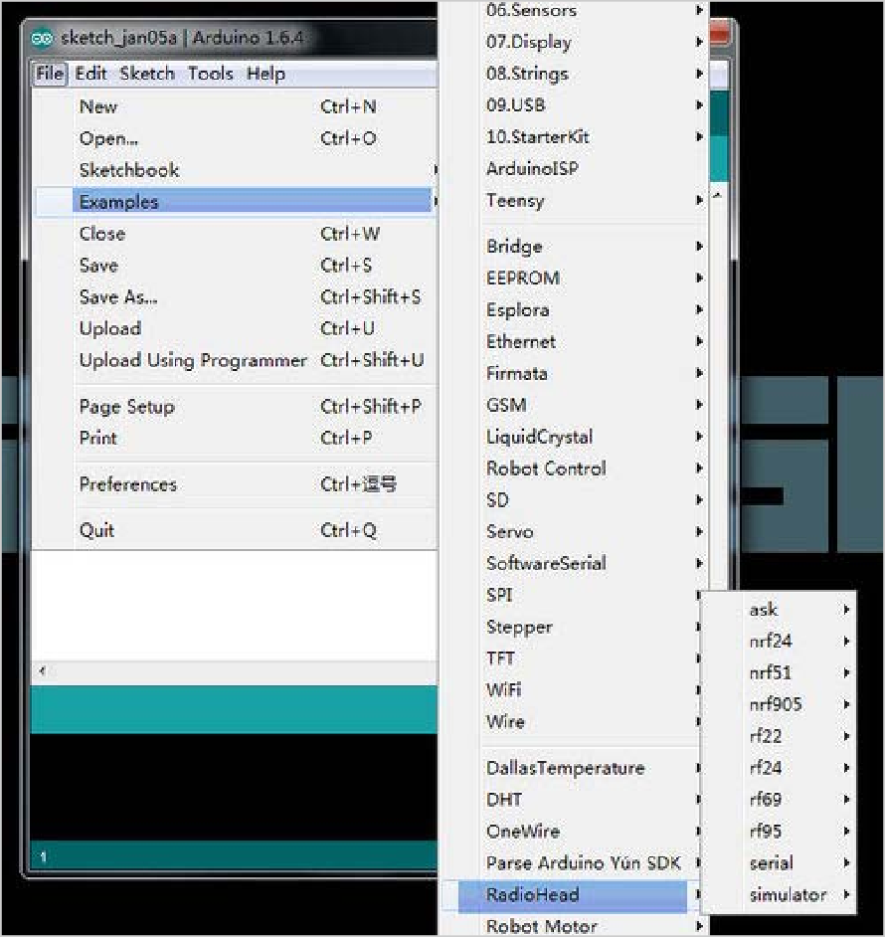
RADIOHEAD LIBRARY
The RadioHead Library simplifies communication between the Arduino Board and the Lora Shield.
We can find it here: http://www.airspayce.com/mikem/arduino/RadioHead/
After putting the library in the right place, you have to modify the frequency to the frequency.

Slide 21
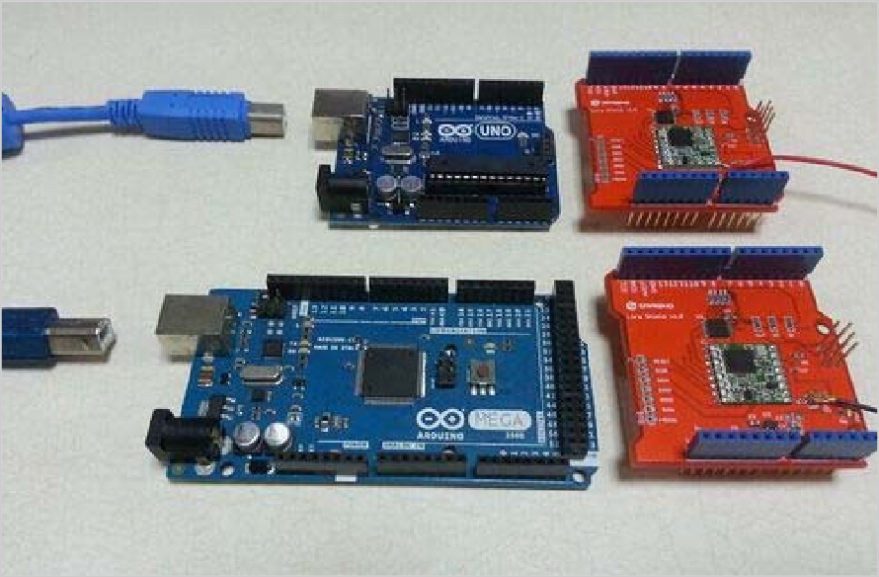
RADIOHEAD LIBRARY
We use two Lora Shields to transmit and receive,the operation is as follows:
Connect two Lora Shields
with Arduino board and connect
them to computer via the
USB cable.

Slide 22
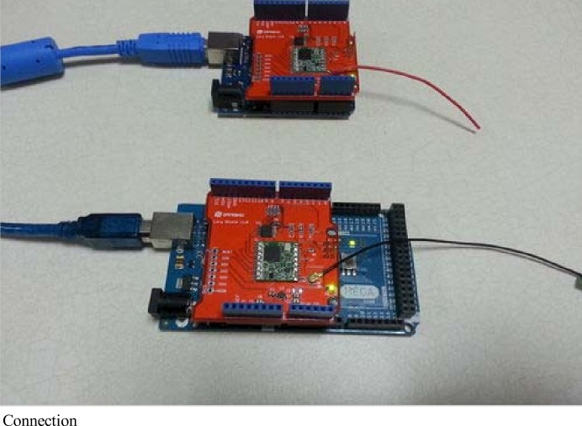
RADIOHEAD LIBRARY
Connect the Lora Shield and Arduino,and connect them to computer.

Slide 23
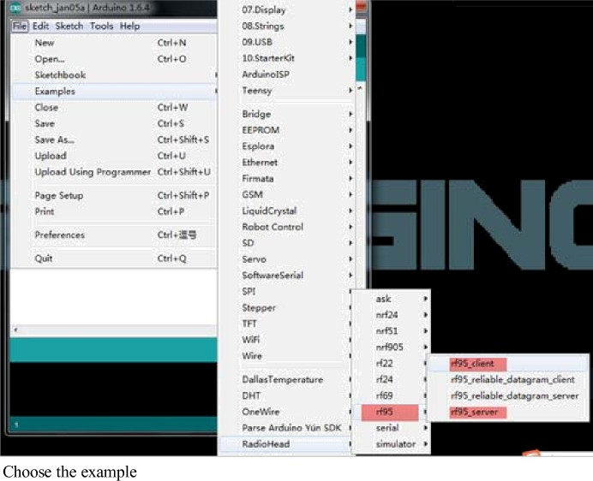
RADIOHEAD LIBRARY
Open the IDE and choose the right example;

Slide 24
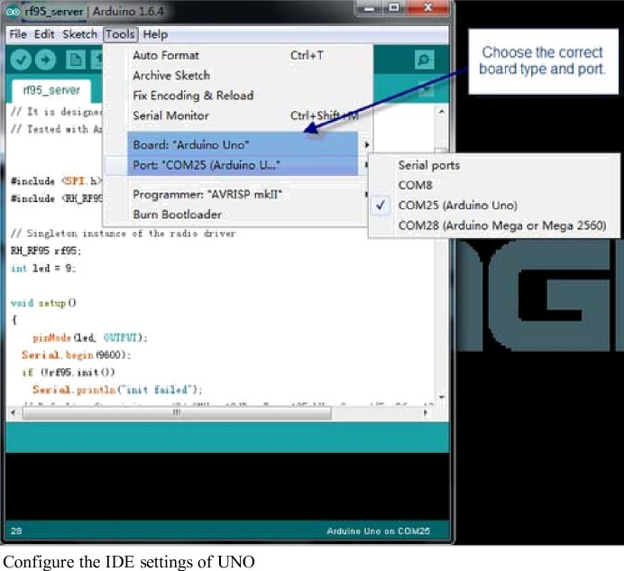
RADIOHEAD LIBRARY
Configure the IDE settings and upload the two skteches to Aduino.

Slide 25
RADIOHEAD LIBRARY
After configure the IDE settings,upload the sketch to Aduino.
Check the Serial Moniter and we can view the running result of the two boards.

Slide 26
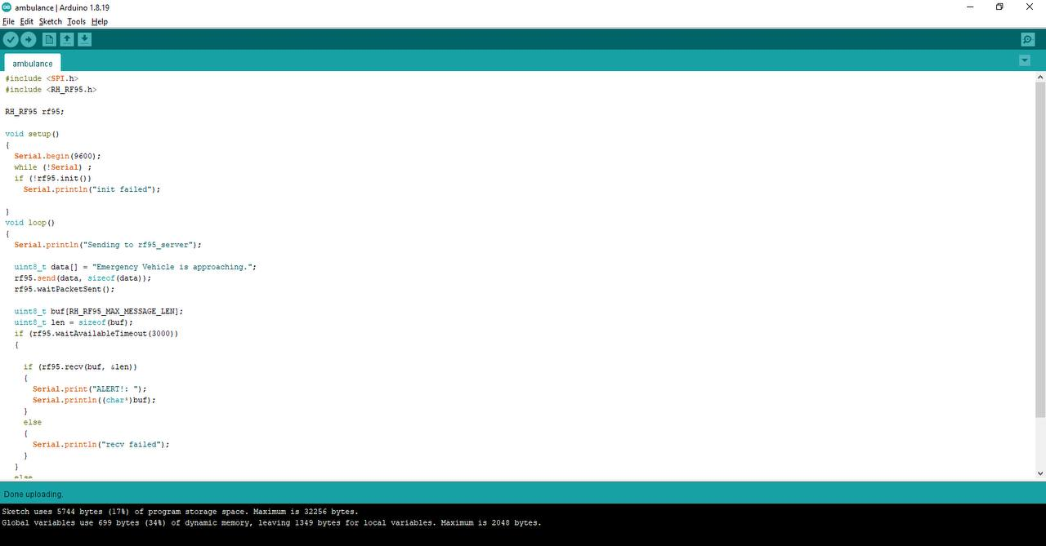
SIMULATION
TRANSMITTER(AMBULANCE)

Slide 27
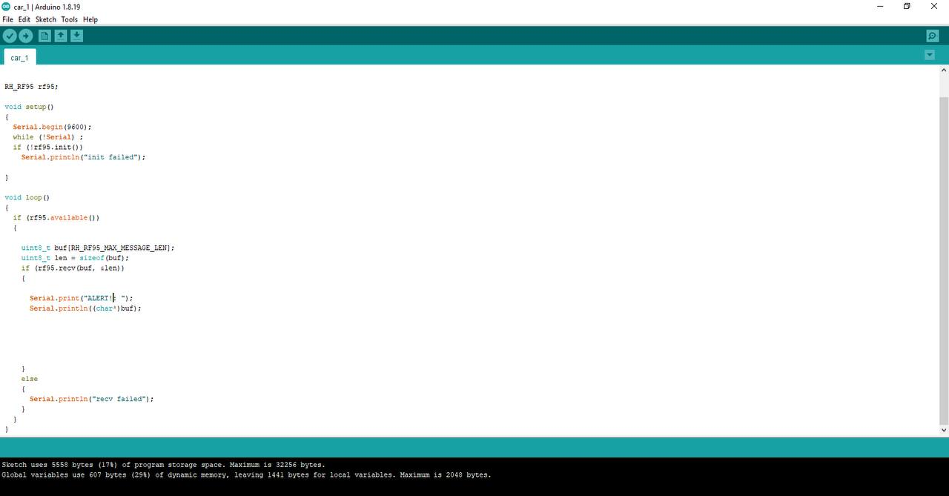
SIMULATION
RECEIVER(OTHER VEHICLE)

Slide 28
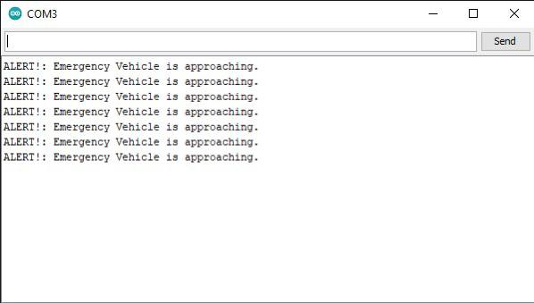
RESULT

Slide 29
CONCLUSION
This proposed work involves the development of an emergency vehicle alert system that enables emergency vehicle operators to warn other cars in front of them to move aside.
This system will be ideal for low-range, medium-range, and long-range communications.
Future generations of autonomous cars might use the suggested Advanced Emergency Vehicle Alert System.

Slide 30
REFERENCE
[1] Bosquez, C., Moreira, R., & De La Cruz, A. (2017, November). Alert system for emergency vehicles using software-defined radio. In 2017 IEEE International Conference on Microwaves, Antennas, Communications and Electronic Systems (COMCAS) (pp. 1-5). IEEE.
[2] Kobayashi, T., Kimura, F., Imai, T., & Arai, K. (2019). Smart ambulance approach alarm system using smartphone. IEICE TRANSACTIONS on Information and Systems, 102(9), 1689-1692.
[3] Roopashree, V., Malavika, D. N., Bai, E. N., Suman, A., & Shashikala, D. R. (2020). Traffic congestion detection and Alerting Ambulance using IOT. Int J Eng Res Tech, 9(7), 1339-1343.
[4] Widianto, E. D., Pakpahan, M. S., & Septiana, R. (2018, October). LoRa QoS performance analysis on various spreading factor in Indonesia. In 2018 International Symposium on Electronics and Smart Devices (ISESD) (pp. 1-5). IEEE.

